Slide 1
Conway’s Game of Life
A Python Course Exercise

Slide 2
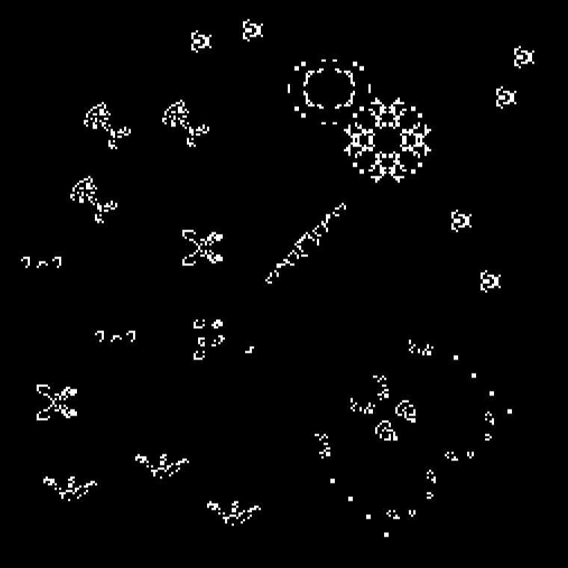
What is Game of Life?
Game of life was created by the British mathematician John Conway in 1970.
It is a 2D cell automation where a user creates initial 2D configurations and observes how the initial configuration evolves based on the rules.
The games is composed of a two dimensional array.
Each cell in the 2D array contains one of two possible states. Dead or Alive.

Slide 3
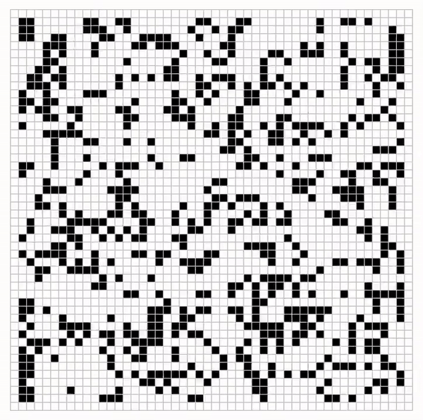
Mechanics
Underpopulation
If a cell is Alive and has fewer than two neighbors that are Alive, it turns Dead
Stasis
If a cell is Alive and has either two or three neighbors that are Alive, it remains Alive.
Overpopulation
If a cell is Alive and has more than three neighbors that are Alive, it turns Dead.
Reproduction
If a cell is Dead and has exactly three neighbors that are Alive, it turns Alive

Slide 4





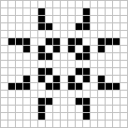


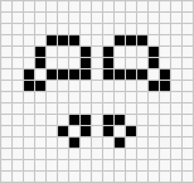


Game of Life Implementation in Python
Using Matplotlib and Numpy is not allowed.
Display the 2D world in console window.
Create a 30x30 2D world.
Represent a Dead cell as the Unicode character⬛ ("\u2B1B“), and an Alive cell as ⬜("\u2B1C“). This is assuming you have a black background. Invert this if you plan to display in white background. Displaying the world should be implemented as a function that accepts a 2D array.
Clear the screen before each iteration.

Slide 5
Game of Life Implementation in Python
The program should have two modes. Your code should accept a parameter.
Read a CSV configuration file to initialize the 2D world. You pass –i filename parameter when running your code.
Or Initialize the word with random cell states. No –i parameter passed when running the code.
Rules should be applied on each cells in each iteration before updating the display. You may maintain two arrays (e.g. current_state, and next_state). You loop in current array and apply rules, then result is stored in the 2nd array. Once iteration is done, set next_state as the current_state and display.
Iterations should have at least 1 second interval in between and not greater than 5 seconds.
Simulation can be halted/resumed by pressing the space key. Use Keyboard events/interrupts. (last priority)

Slide 6
Code

Slide 7
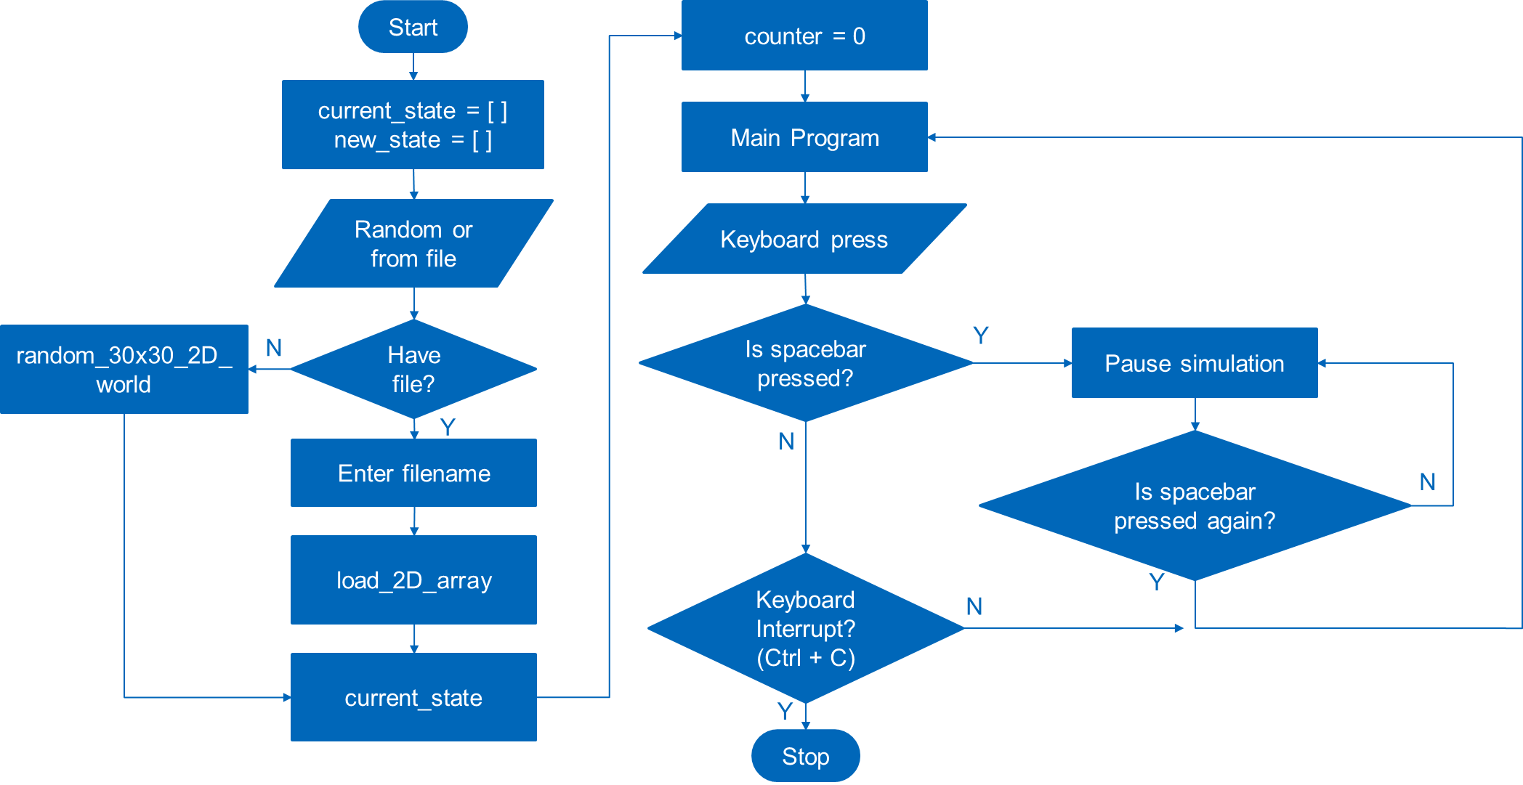
Program Flow

Slide 8
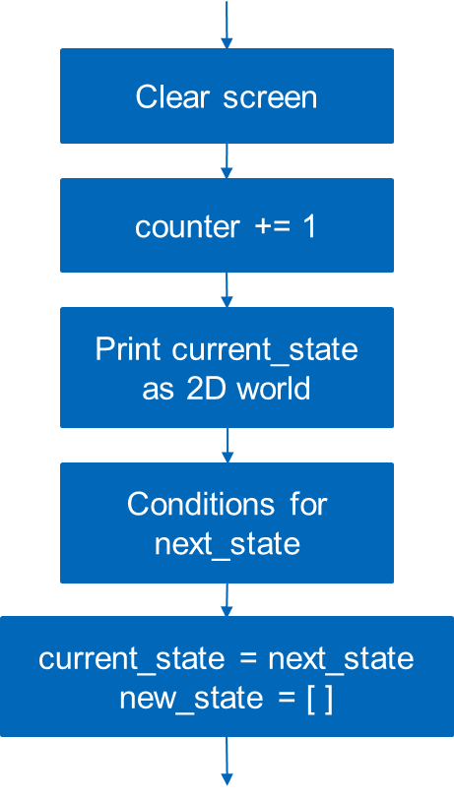
Program Flow
Main Program

Slide 9
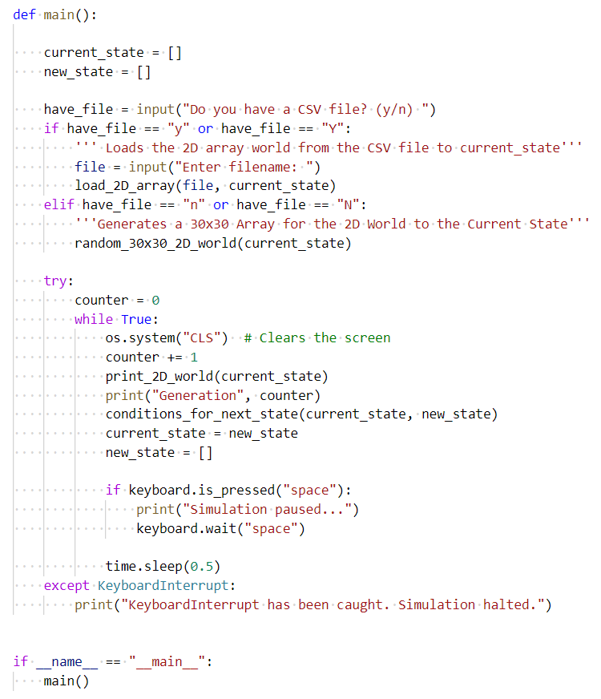
Main Code

Slide 10
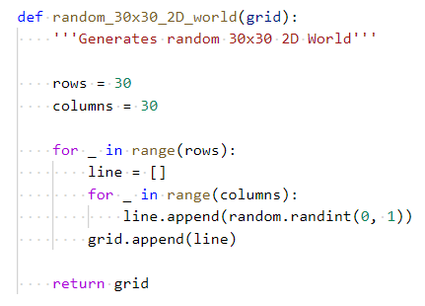
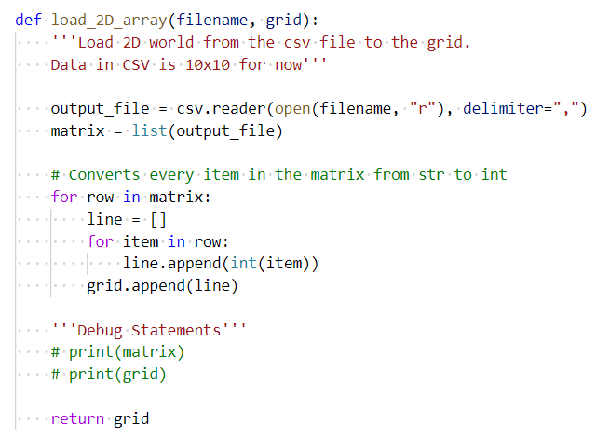
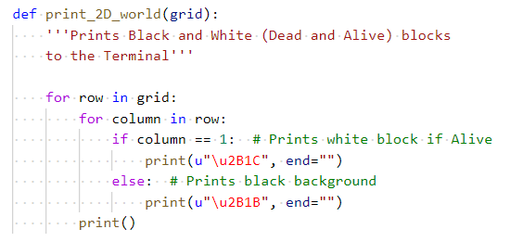
Functions

Slide 11
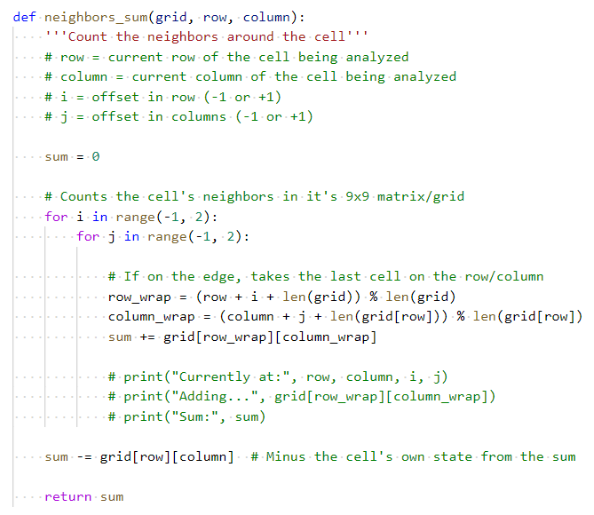
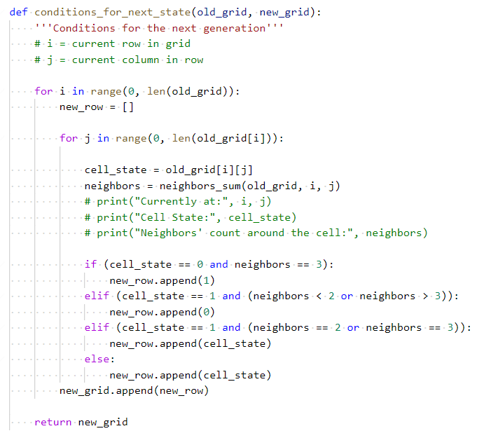
Functions

Slide 12
Learnings

Slide 13
Helpful Topics From The Course
Functions
Loops
Exception Handling
Data Structures
Debugging
Useful for organizing and reusing blocks of codes
Useful for iterating through each element on a list or a 2D array
Useful for executing certain codes when an error is caught
Useful in handling data randomly generated or given by the user
Useful in checking if your code is running as expected

Slide 14
Helpful Tips When Taking The Course
Take down notes. Write down what you learned. Notes written on a piece of paper lasts longer than your short-term memory.
Think in small chunks. Think as if writing a detailed procedure when writing code.
Minimize distractions.
When overwhelmed, don’t overdo it. Rest. Sleep.

